Slide 1
IS 6640 – Networking and Servers
Jon Soldan
Operations and Information Systems

Slide 2
Agenda – 8/26
Welcome and Course Introduction
Chapter 1 – Panko Book

Slide 3
My Background
Education:
MBA – Utah State University
MS – Information Systems, University of Utah
BA – Economics, University of Utah
Certifications
Project Management Professional (PMP)
Certified Scrum Professional (CSP)
Certified Scrum Master (CSM)
Certified Information Systems Security Professional (CISSP)
Microsoft Certified Technology Specialist (MCTS)
ITIL v3 Foundations
Professional Associations
Utah CIO, CIO Executive Council, Association for Information Management (AIM), ISC2
Project Management Institute (PMI), PMI Information Systems Specific Interest Group (PMI ISSIG), PMI Northern Utah Chapter (PMI NUC)

Slide 4
My Background
Senior Vice President, Client Services – Property Solutions International
Vice President, Professional Services – Property Solutions International
Senior Director, PMO – Property Solutions International
Director, IT Project Management Office - Progrexion Holdings
Assistant Professor (Lecturer) – U of U
Director, Information Systems Programs – U of U
Senior IT Project Manager at LDS Church, StayWell Interactive, Galileo Processing, Verizon Wireless

Slide 5

Welcome to the Cloud
Chapter 1

Slide 6
Into the Cloud
Basic Network Concepts
Packet Switching
Internetworking
Internet Standards
A Small Home Network
Layers

Slide 7
Case Studies
Jason
Claire
John

Slide 8
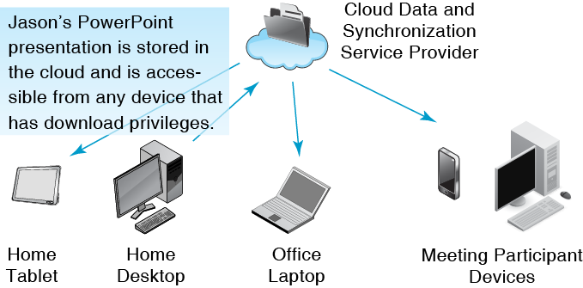
1.2: Cloud File Synch/Distribution
The cloud imagery indicates that the user does not have to understand how systems “inside the cloud” operate.

Slide 9
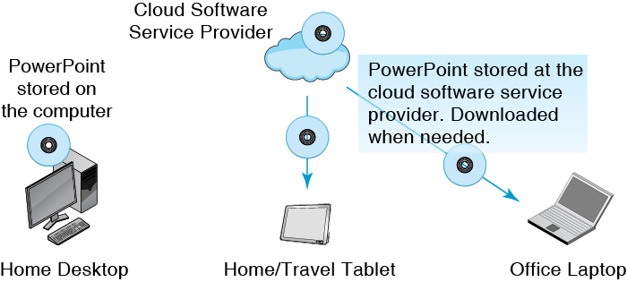
1.3: Software in the Cloud

Slide 10
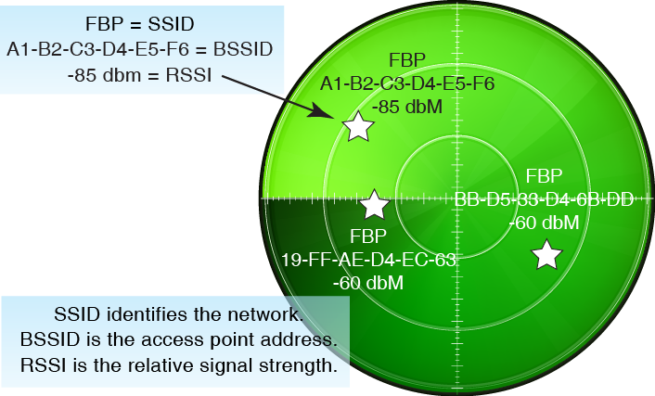
1.4: Wireless Sniffer Radar Map

Slide 11
1.5: Wireless Sniffer Details Table
SSID | FBP | FBP | FBP
BSSID | A1-B2-C3-D4-E5-F6 | BB-D5-33-D4-6B-DD | 19-FF-AE-D4-EC-63
Signal | -85 dBm | -60 dBm | -60 dBm
Mode | 802.11g | 802.11n | 802.11n
Channel | 11 | 48 | 44
Encryption | AES-CCMP | AES-CCMP | AES-CCMP
Authentication | WPA2/PEAP | WPA2/PEAP | WPA2/PEAP
Vendor | Cisco | Cisco | Cisco

Slide 12
Into the Cloud
Basic Network Concepts
Packet Switching
Internetworking
Internet Standards
A Small Home Network
Layers

Slide 13
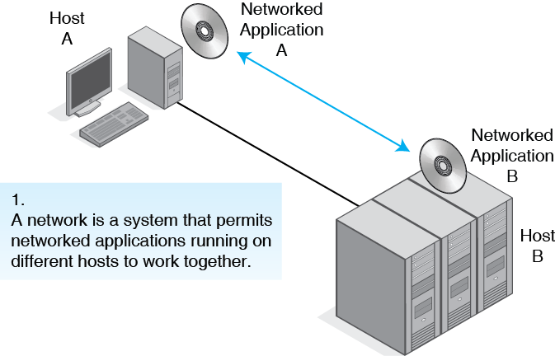
1.6: Basic Network Terminology
Working Definition
Notes:
Host is any machine.
Application is any software.

Slide 14
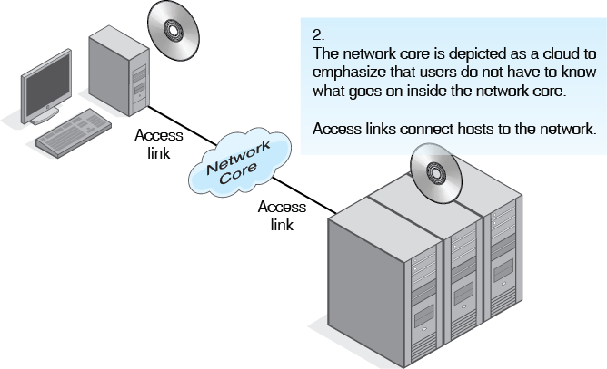
1.6: Basic Network Terminology

Slide 15
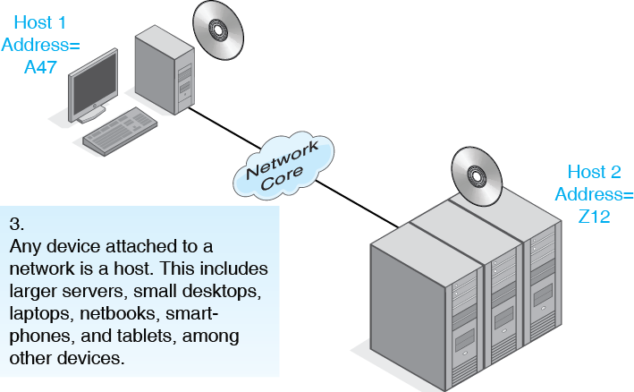
1.6: Basic Network Terminology

Slide 16
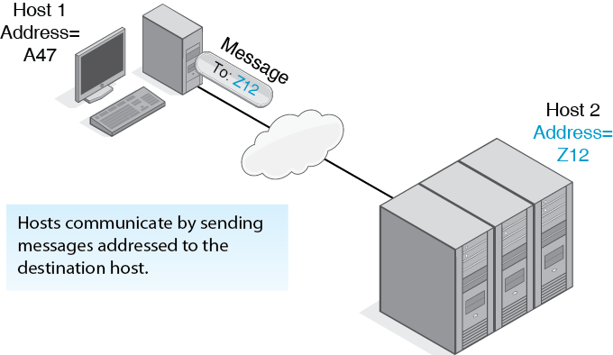
1.6: Basic Network Terminology

Slide 17
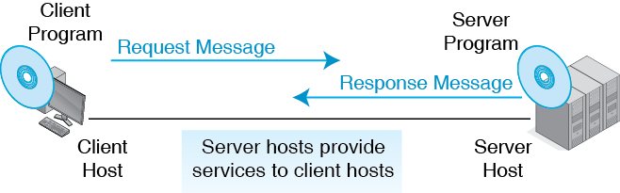
1.7: Client/Server Processing
The client and the server share processing work.

Slide 18

1.8: Peer-to-Peer (P2P) Processing
P2P Processing can be done without a network (as shown) or with a network. No servers are needed.

Slide 19

1.9: Transmission Speed
Transmission Speed Measurements
Bits per second (bps)
Usually not bytes per second (Bps)
Metric Suffixes
Kilobits per second | kbps (lowercase k) | 1,000 bits per second (not 1,024)
Megabits per second | Mbps | 1,000 kbps
Gigabits per second | Gbps | 1,000 Mbps
Terabits per second | Tbps | 1,000 Gbps

Slide 20
1.10: Download Times for Applications
File Downloads | 100 kbps | 1 Mbps | 5 Mbps | 10 Mbps | 100 Mbps | 1 Gbps
E-mail message (250 words) | .15 s | 0 s | 0 s | 0 s | 0 s | 0 s
Photograph (5 MB) | 8 m | 1 m | 10 s | 5 s | 1 s | 0.1 s
1 Hr HTDV Video (10 Mbps) | 4 d | 10 h | 2 h | 1 h | 6 m | 36 s
Backup Synch (10 GB) | 12 d | 28 h | 6 h | 3 h | 17 m | 2 m

Slide 21
1.10: Download Times for Applications
Live or Streaming Media | 100 kbps | 1 Mbps | 5 Mbps | 10 Mbps | 100 Mbps | 1 Gbps
MP3 Song (10 kbps) | OK | OK | OK | OK | OK | OK
Standard Quality TV (2 Mbps) |  |  | OK | OK | OK | OK
HDTV (10 Mbps) |  |  |  | OK | OK | OK
Three HDTV Channels |  |  |  |  | OK | OK

Slide 22
Into the Cloud
Basic Network Concepts
Packet Switching
Internetworking
Internet Standards
A Small Home Network
Layers

Slide 23

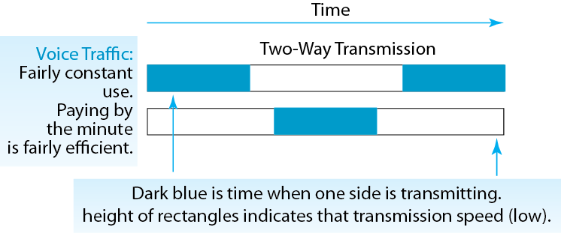
1.11: Data Burstiness

Slide 24
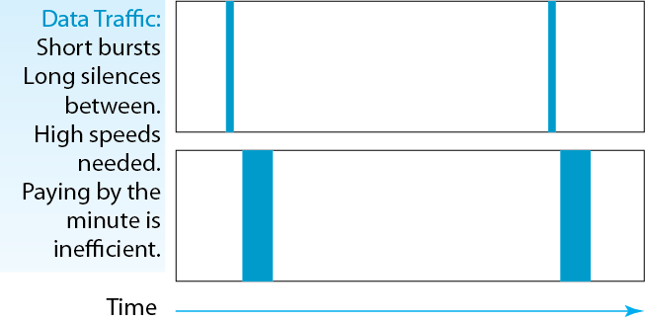
1.11: Data Burstiness

Slide 25
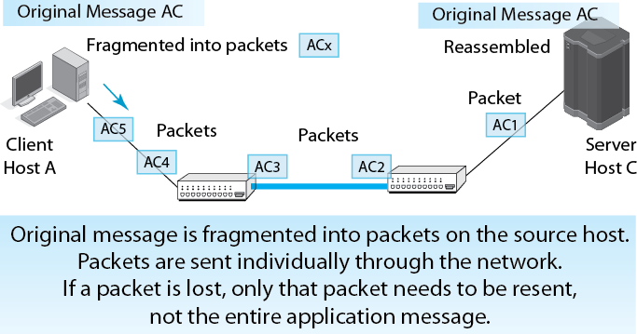
1.12: Packet Switching and Multiplexing

Slide 26
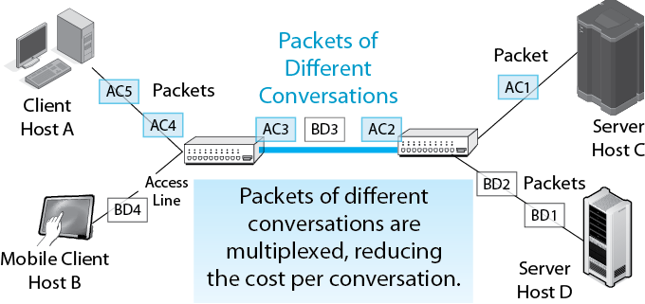
1.12: Packet Switching and Multiplexing

Slide 27
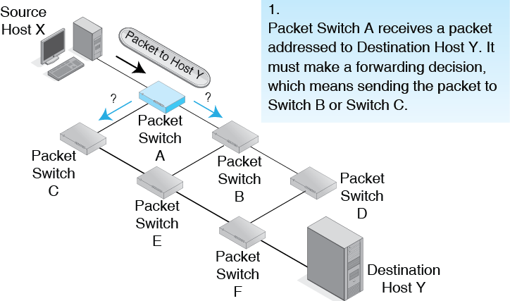
1.13: Sequential Switching Decisions

Slide 28
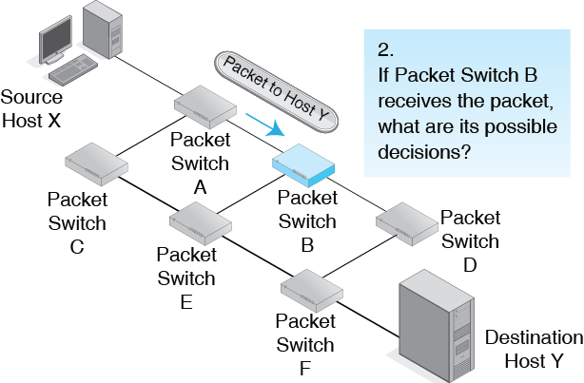
1.13: Sequential Switching Decisions

Slide 29
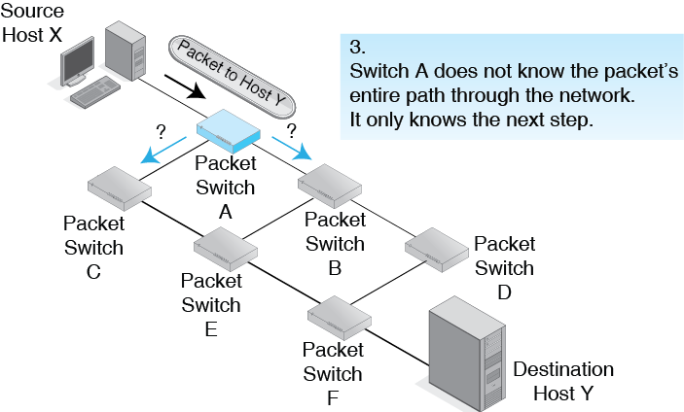
1.13: Sequential Switching Decisions

Slide 30
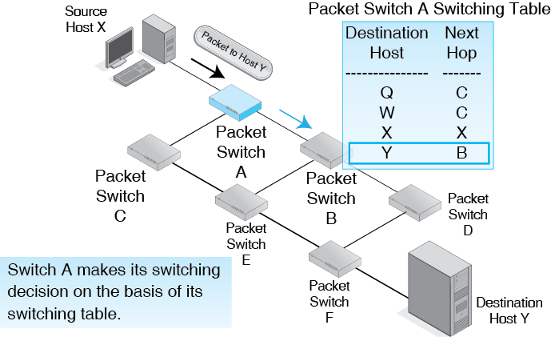
1.14: Address-Based Switch Forwarding Decision

Slide 31
Recap
Each switch along the way forwards the packet out a port to another switch (or to the destination host).
Individual packet switches have no knowledge of the entire path taken by the packet.
We will see how this works in detail in later chapters.

Slide 32
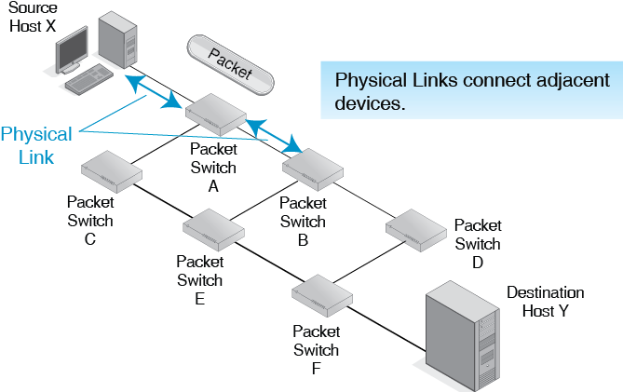
1.15: Physical and Data Links

Slide 33
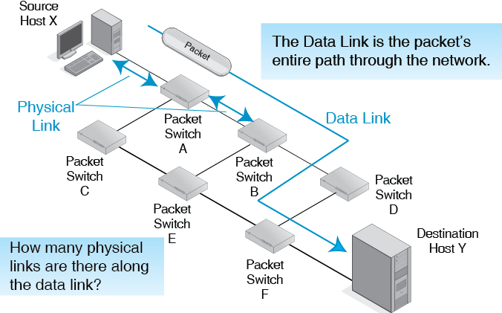
1.15: Physical and Data Links

Slide 34

The ARPANET
Forerunner of the Internet
Funded by Larry Roberts at the Advanced Research Projects Agency (ARPA)
Now the Defense Advanced Research Projects Agency (DARPA)
To explore packet switching
To give researchers access to ARPA-funded software on host computers in distant cities
First four nodes began operation in 1969

Slide 35
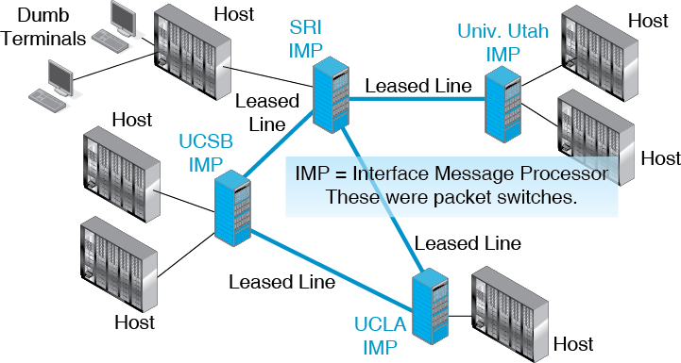
1.16: The ARPANET

Slide 36
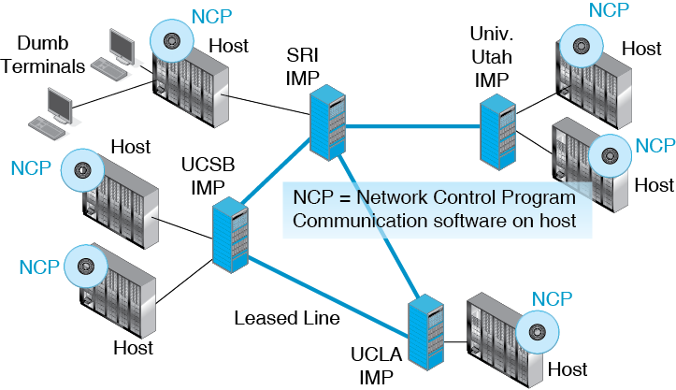
1.16: The ARPANET

Slide 37
Into the Cloud
Basic Network Concepts
Packet Switching
Internetworking
Internet Standards
A Small Home Network
Layers

Slide 38
Birth of the Internet
Bob Kahn at DARPA needed a way for researchers on one network to use resources on another network.
Packets would have to travel across multiple networks.
Kahn and Vint Cerf came up with the idea of connecting multiple networks by devices called routers.
The original name was gateways.
Generically, networks of networks are internets.
Kahn created the global Internet (Capital I).

Slide 39
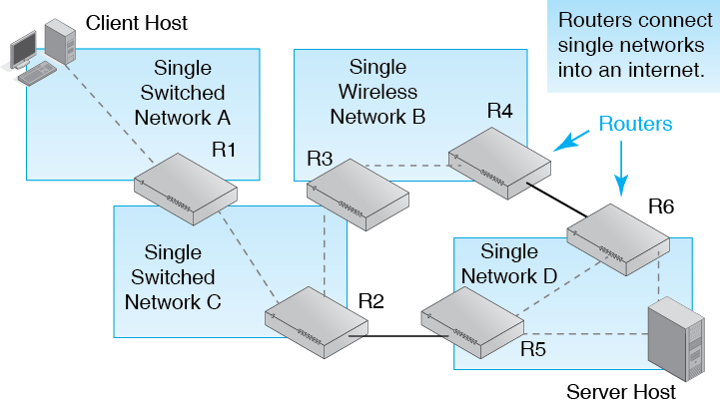
1.17: Internet

Slide 40
1.18: Two Layers of Networking
Basically, Kahn and Cerf created a second layer of networking on top of single networks.
This required the creation of a parallel set of concepts for single networks and internets.
Single networks and internets use similar concepts but give these concepts different names.
It is important for you to get this clear in your head.

Slide 41
1.18: Two Layers of Networking
Component | Generic Terminology | Single Networks | Internets
Addresses |  | Vary by network technology | 32-bit IPv4 Addresses and 128-bit IPv6 Addresses
Packets are called | Packets | Frames | Packets
Packet switches are called | Switches | Switches | Routers
End-to-end routes are called |  | Data links | Routes

Slide 42
1.18: Two Layers of Networking
Component | Generic Terminology | Single Networks | Internets
Addresses |  | Vary by network technology | 32-bit IPv4 Addresses and 128-bit IPv6 Addresses
Packets are called | Packets | Frames | Packets
Packet switches are called | Switches | Switches | Routers
End-to-end routes are called |  | Data links | Routes

Slide 43
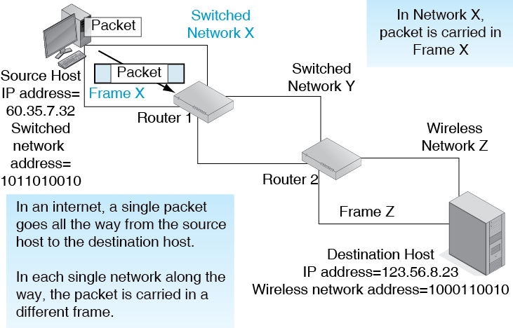
1.19: Packets and Frames

Slide 44
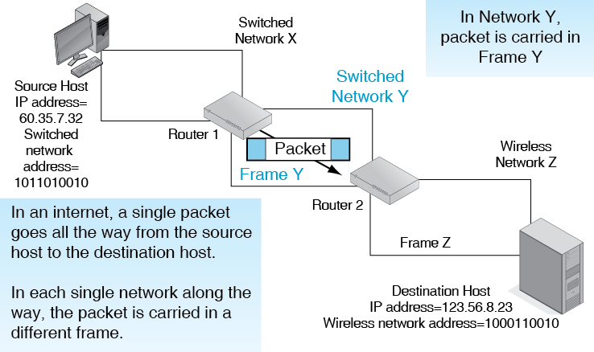
1.19: Packets and Frames

Slide 45
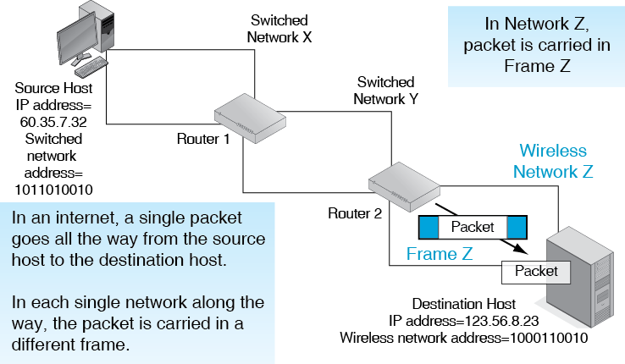
1.19: Packets and Frames

Slide 46
Into the Cloud
Basic Network Concepts
Packet Switching
Internetworking
Internet Standards
A Small Home Network
Layers

Slide 47
Network layers
Networks can be described at several layers of detail.
Each layer provides services to the layer above it.
The road provides service to the car tires.
The car tires provide service to the car.
The car provides service to the driver.
A commercial driver provides service to the goods being delivered.

Slide 48
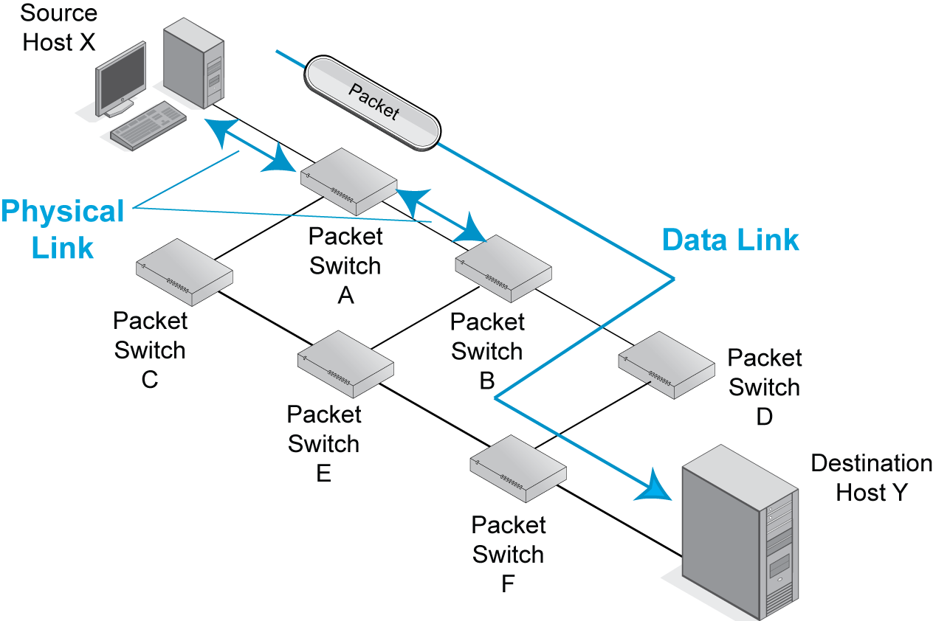
1.20: Physical Links and Data Links
2.
The data link is the packet’s
path through the network
In this case: X-A-B-D-F-Y
1.
Physical links are
connections between
adjacent pairs of devices

Slide 49
1.20: Physical Links and Data Links
How many data links does the packet pass through?
How many physical links does the packet pass through?
Name them.

Slide 50
Network Working Group
Formed by graduate students to create standards for the ARPANET.
Called their standards Requests for Comment (RFCs).
Did not feel that they had the authority to create standards, so they used the weaker term RFC.
The NWG evolved into today’s standards body for the Internet, the Internet Engineering Task Force (IETF).
Internet standards today are still called RFCs.

Slide 51
Two Layers of Networking
Basically, Kahn and Cerf created a second layer of networking on top of single networks.
This required the creation of a parallel set of concepts for single networks and internets.
Single networks and internets use similar concepts but give these concepts different names.
It is important for you to get this clear in your head.

Slide 52
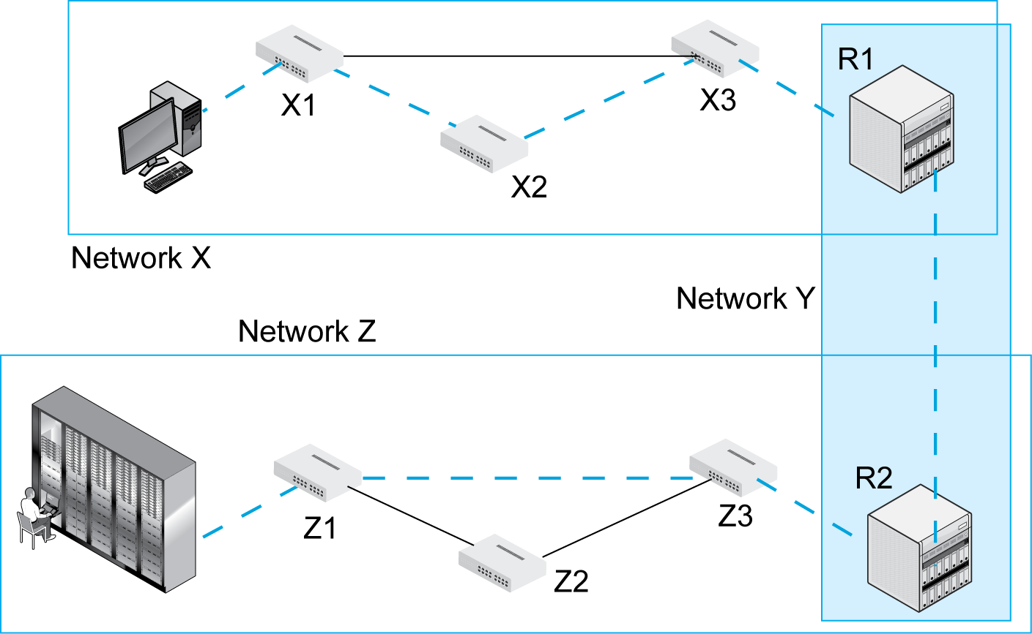
1.20: Physical Links, Data Links, and Routes
Dashed line shows
the path of a packet

Slide 53
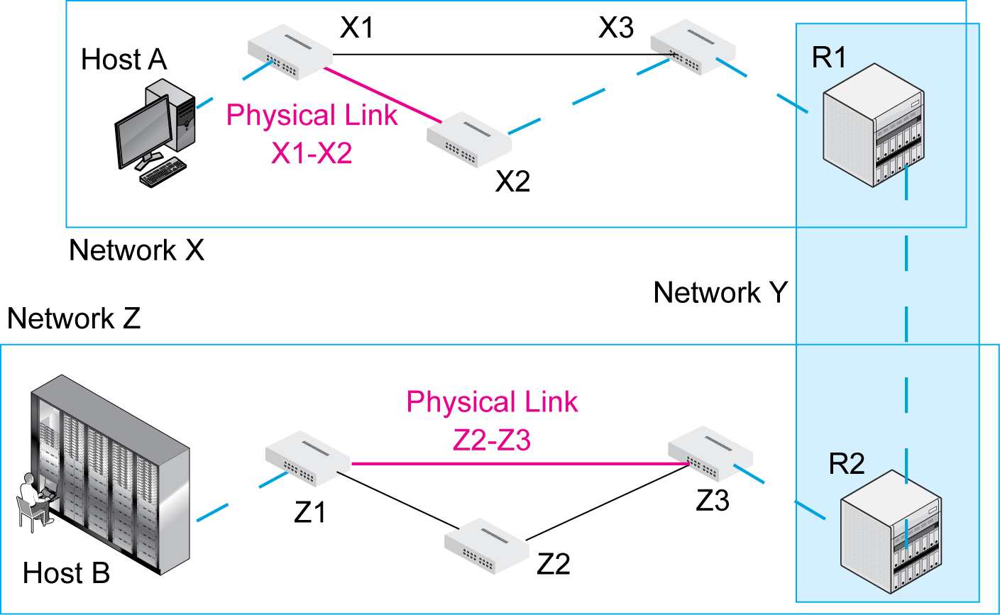
1.20: Physical Links, Data Links, and Routes
Physical links connect adjacent devices,
as noted earlier.
How many
physical links are there
between the two hosts?

Slide 54
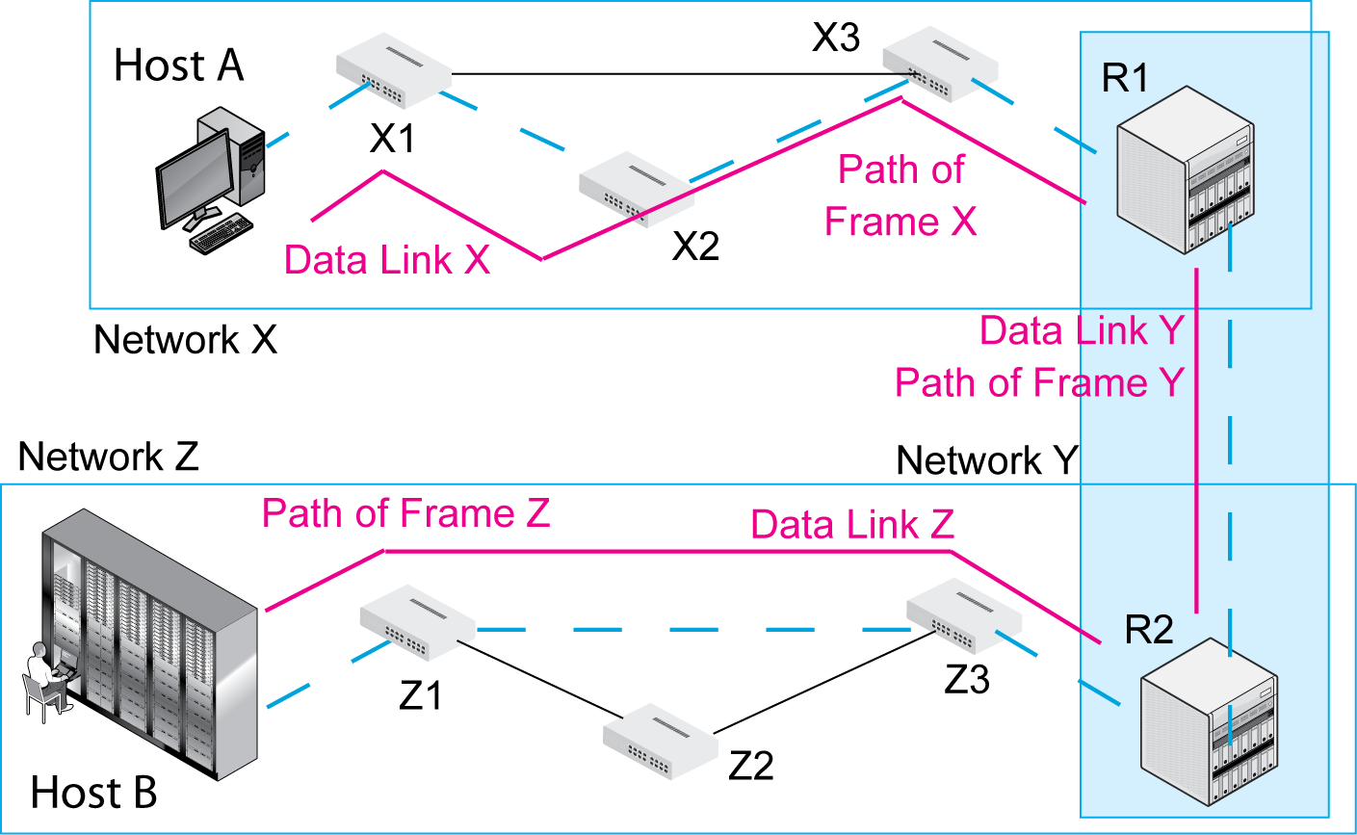
1.20: Physical Links, Data Links, and Routes
A data link is the path of a frame through a single network, as noted earlier.
There is one data link per network.
How many data links are in the figure?

Slide 55
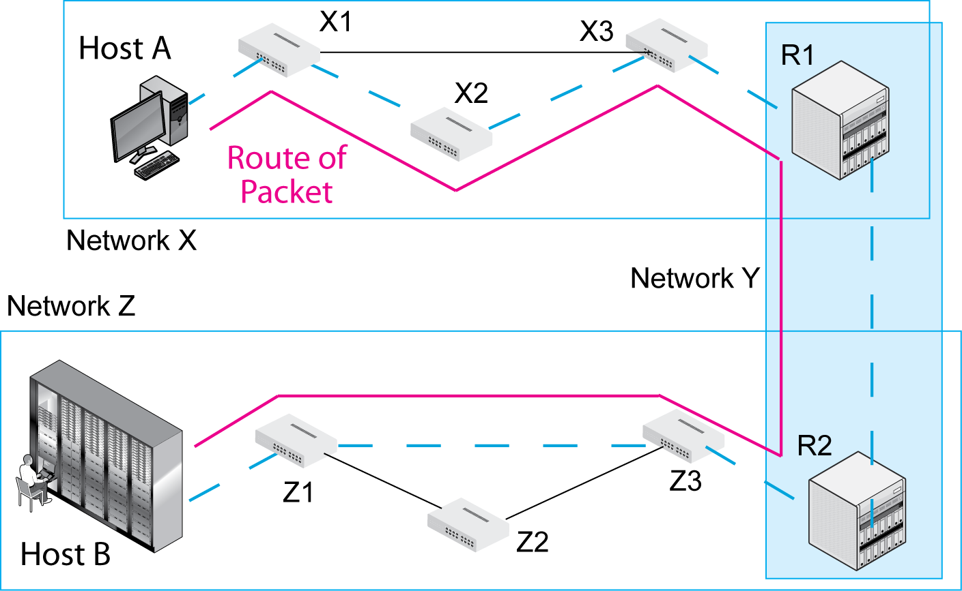
1.20: Physical Links, Data Links, and Routes
A route is a packet’s path through an internet.
Added for internets.
How many routes are there in the figure?

Slide 56
1.20: Physical Links, Data Links, and Routes
Host P transmits a packet to Host Q.
There are seven networks between the hosts.
1. How many packets will there be along the way?
2. How many frames will there be along the way?
3. How many routes will there be along the way?
4. How many data links will there be along the way?

Slide 57
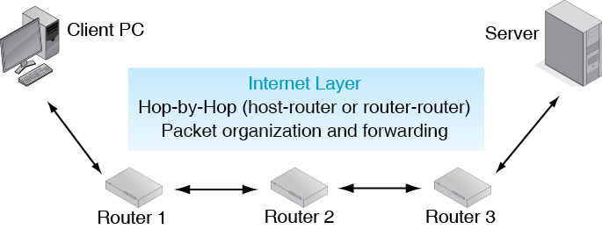
1.21: Internet and Transport Standards

Slide 58
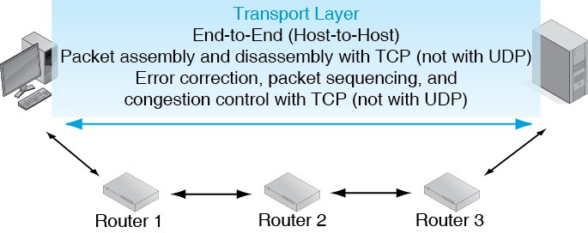
1.21: Internet and Transport Standards

Slide 59
1.22: Networking Layers
Layer | Name | Broad Purpose | Specific Purpose
5 | Application
4 | Transport
3 | Internet
2 | Data Link | Single-network transmission (switched or wireless) | Connection across a single network, Frame formats and switch operation
1 | Physical |  | Physical connections between adjacent devices

Slide 60
1.22: Networking Layers
Layer | Name | Broad Purpose | Specific Purpose
5 | Application
4 | Transport | Internet Transmission | Application message fragmentation, error correction, congestion reduction, etc.
3 | Internet |  | Transmission of packet across an internet, Packet formats, router operation
2 | Data Link
1 | Physical

Slide 61
1.22: Networking Layers
Number | Name | Broad Purpose | Specific Purpose
5 | Application | Communication between applications | Same
4 | Transport
3 | Internet
2 | Data Link
1 | Physical

Slide 62
Into the Cloud
Basic Network Concepts
Packet Switching
Internetworking
Internet Standards
A Small Home Network
Layers

Slide 63
1.24: Core TCP/IP Standards
IP
Internet layer protocol
Unreliable best-effort internet layer operation

Slide 64
1.24: Core TCP/IP Standards
TCP
Transport layer protocol
TCP messages are called segments
Provides transport layer functionality to fix problems
Error correction, and so on
UDP
The other transport layer protocol
Messages are called datagrams
Unreliable, so used when reliability is not desired

Slide 65
1.23: Core TCP/IP Standards
Layer | Standard(s)
Transport Layer | Transmission Control Protocol (TCP) Fragmentation Error Correction Congestion control | User Datagram Protocol (UDP) No Fragmentation No Error Correction No Congestion Control
Internet Layer | Internet Protocol (IP) IPv4 and IPv6

Slide 66
The Internet Evolves
1977
First experimental connection of three networks
(Two wireless and the ARPANET)
1980s
Internet opened to outside network for e-mail exchanges

Slide 67
The Internet Evolves
TCP/IP standards evolved in the 1980s
Hosts could run either TCP/IP or NCP standards.
1983
All hosts were required to run TCP/IP.
NSFNET
In the 1980s, the NSFNET funded by NSF was the core of the Internet.
NSF had an Acceptable Use Policy barring commercial activity such as e-commerce.

Slide 68
The Internet Evolves
1995
NSFNET replaced by commercial ISPs.
E-commerce was no longer forbidden.
The e-commerce revolution began.
The World Wide Web became popular just before that.

Slide 69
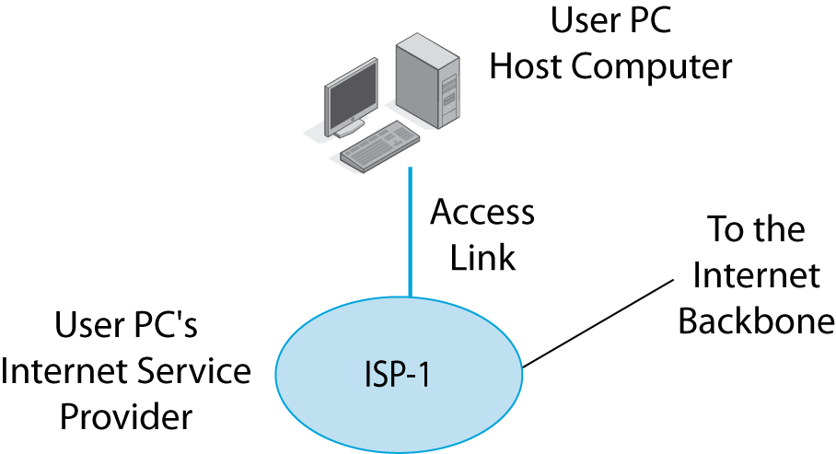
1.24: The Internet Today
To use the Internet,
you need an Internet service provider and an access line to your ISP.
Your ISP gives you access and carries your packets.
Organizations also
need ISPs.

Slide 70
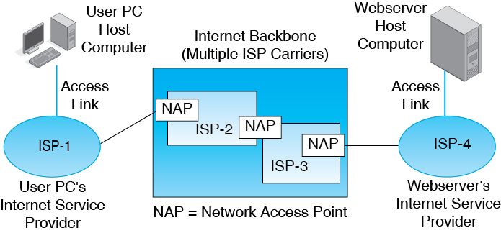
1.24: The Commercial Internet
ISPs collectively comprise the Internet backbone.
They interconnect at Network Access Points (NAPs)
to exchange packets.

Slide 71
1.24: The Commercial Internet
Trace the path packets take from the User PC to the Webserver.

Slide 72
Internet Supervisory Protocols
IP, TCP, and UDP are standards for delivery packets.
TCP/IP also has supervisory protocols:
To handle things beyond packet delivery.
Managing IP addresses.
Error handling, and so on.
We will look at two supervisory protocols in this chapter.
We will look at many more in Chapter 10.

Slide 73
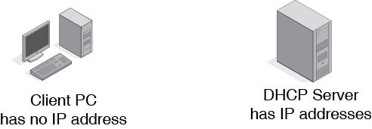
1.25: Dynamic Host Configuration Protocol

Slide 74
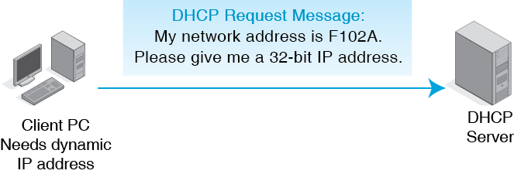
1.25: Dynamic Host Configuration Protocol

Slide 75
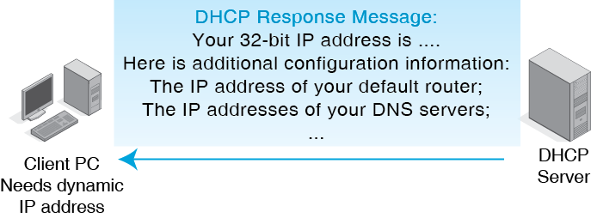
1.25: Dynamic Host Configuration Protocol

Slide 76
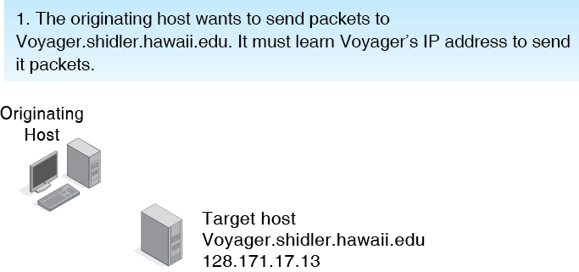
1.26: Domain Name System (DNS)

Slide 77
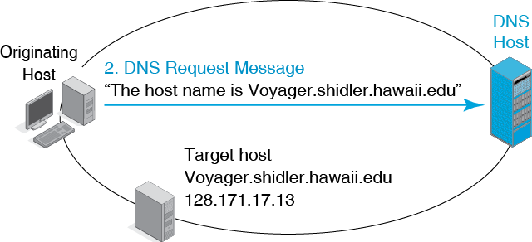
1.26: Domain Name System (DNS)

Slide 78
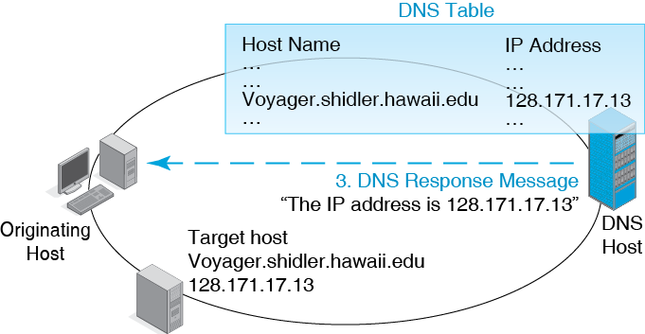
1.26: Domain Name System (DNS)

Slide 79
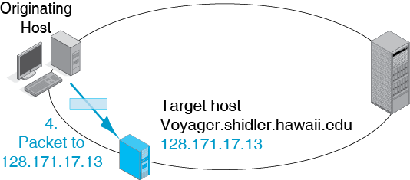
1.26: Domain Name System (DNS)

Slide 80
Into the Cloud
Basic Network Concepts
Packet Switching
Internetworking
Internet Standard
A Small Home Network
Layers

Slide 81
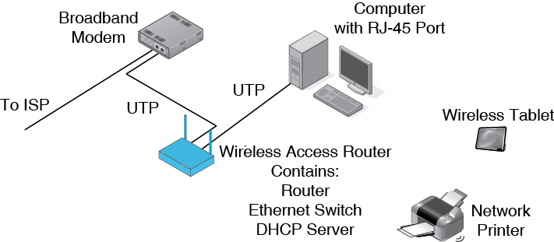
1.27: Home Network

Slide 82
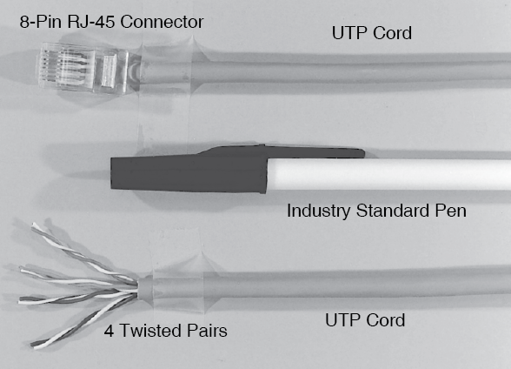
1.28: Four-Pair Unshielded Twisted Pair (UTP)

Slide 83
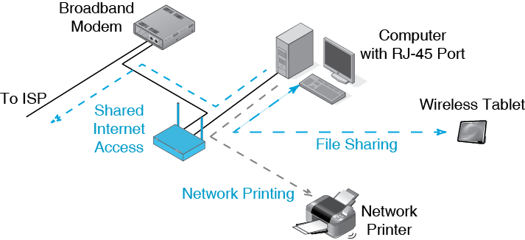
1.27: Home Network

Slide 84
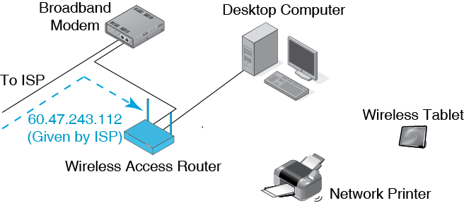
1.29: DHCP in a Small Home Network
The IP gives the home one IP address.
The home network has multiple devices that need IP addresses.

Slide 85
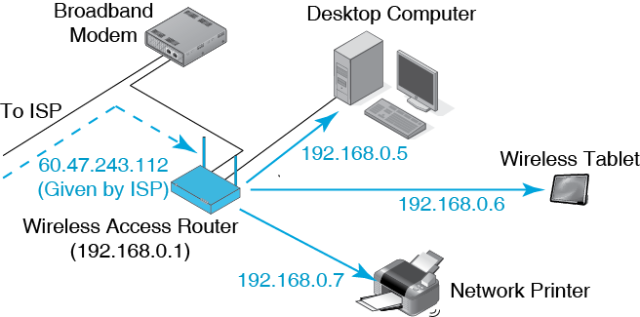
1.29: DHCP in a Small Home Network
The access router DHCP circuit gives
private IP addresses to other devices.

Slide 86
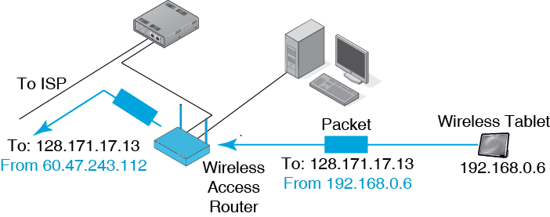
1.30: Network Address Translation (NAT)
NAT allows multiple internal hosts to share a single external IP address.
External sniffers cannot learn internal addresses.

Slide 87
Into the Cloud
Basic Network Concepts
Packet Switching
Internetworking
Internet Standard
A Small Home Network
Layers

Slide 88
The Next Chapter
Chapter 2 looks at standards in more depth.
It will look at major characteristics of standards, such as the syntax of messages.
It will focus on the data link, internet, transport, and application layers, which work by sending structured messages.

